Slide 1

Group Research Project On Crypto-Currency
Reported by: Krijal Paneru(Coordinator)
MBMC-GROUP STUDY CENTRE (GSC) FOR FUNDAMENTS TO ADVANCED COMPUTING
Team members:
Roj Dahal
Ankit Shrestha
Srijana Subedi
Purnika Kalu
Swoichya Shrestha
Subarna Katwal
Student of BCA 1st semester-2079

Slide 2
Crypto-Currency
Cryptocurrency is a digital asset designed to work as a medium of exchange. It uses cryptography to secure and verify transactions, as well as to control the creation of additional units of the currency.
Cryptocurrency is decentralized, meaning it is not regulated by any government or central bank. This allows for more freedom and autonomy, as well as more potential for profit. The term "crypto" refers to the encryption algorithms and cryptographic techniques used to secure certain entries, such as elliptical curve encryption, public-private key pairs, and hashing functions.
Cryptocurrencies can be mined or purchased from cryptocurrency exchanges. Not all e-commerce sites allow purchases using cryptocurrencies. In fact, cryptocurrencies, even popular ones like Bitcoin, are hardly used for retail transactions. However, the skyrocketing value of cryptocurrencies has made them popular as trading instruments. To a limited extent, they are also used for cross-border transfers. - [1][2][3]

Slide 3
How Does Cryptocurrency Work??
Cryptocurrencies run on a distributed public ledger called blockchain, a record of all transactions updated and held by currency holders.
Units of cryptocurrency are created through a process called mining, which involves using computer power to solve complicated mathematical problems that generate coins. Users can also buy the currencies from brokers, then store and spend them using cryptographic wallets.
If you own cryptocurrency, you don’t own anything tangible. What you own is a key that allows you to move a record or a unit of measure from one person to another without a trusted third party.
Although Bitcoin has been around since 2009, cryptocurrencies and applications of blockchain technology are still emerging in financial terms, and more uses are expected in the future. Transactions including bonds, stocks, and other financial assets could eventually be traded using the technology.
-[4][5][6][7]

Slide 4
Pros-
Currency exchange is now free of headaches time and interruption.
Crypto is legalized in many countries and is imagined to be the future of currencies.
Cons-
Criminal activities are hard to track
Loss of Authenticating key will lead to loss of money – once it is gone then you have to say bye see you, no recovery.
It is decentralized but still, some cryptocurrencies are controlled by their creators or owner – this will arise fraudulent cases of loss of money in cryptocurrency if the owner betrays you.
Mining is not easy – it takes a lot of patience, electricity, a powerful computer, and good luck as we are just simply guessing the nonce.
Although it is very hard to hack if anyone hacks the system then unlike in banks there won’t be a single refund or any kind of compensation drama.
If you mistakenly send money to the wrong address, then it is very likely to say bye to that transaction. No trace is to be recorded.

Slide 5
Cryptography
﻿ Cryptography is the practice of securing communication and information by transforming plaintext into unreadable ciphertext, using a set of mathematical algorithms and protocols known as cryptographic techniques. These techniques include encryption, authentication, and digital signatures, among others.
Encryption is the process of converting plaintext into ciphertext, using a secret key and an encryption algorithm. The ciphertext is unreadable without the corresponding decryption key. This technique is used to protect sensitive information from unauthorized access.
Authentication is the process of verifying the identity of a user or a device. This is done using a variety of methods, such as usernames and passwords, biometric data, or digital certificates.
-[8][9][10][11]

Slide 6
A digital signature is a mathematical scheme that allows the creator of the signature to prove the authenticity and integrity of the message. It is based on public key cryptography and it allows to verify that the sender is the true sender and that the content of the message has not been modified during the transmission.
Cryptography also plays a crucial role in the functioning of blockchain technology, the underlying technology of cryptocurrencies. Blockchain is a decentralized and distributed digital ledger that records transactions across a network of computers. The transactions on the blockchain are secured using cryptographic algorithms, making it extremely difficult for anyone to tamper with the data.
Cryptography is a complex field and many different cryptographic techniques are used to secure communication and information. The security of these techniques depends on the strength of the underlying mathematical algorithms and protocols, as well as on the secrecy of the keys used. -[12][13]

Slide 7
So we know cryptocurrency based on Blockchain Technology but what actually blockchain is
﻿ Blockchain is a decentralized and distributed digital ledger that records transactions across a network of computers. It is the technology that underlies cryptocurrencies like Bitcoin, but it can also be used for a variety of other applications, such as supply chain management, voting systems, and digital identity verification.
A blockchain is composed of a series of blocks, each of which contains a number of transactions. Each block is linked to the previous block in the chain, using cryptographic techniques, creating a chain of blocks, hence the name "blockchain."
One of the key features of blockchain is that it is a distributed system, which means that there is no central authority or intermediary that controls the network. Instead, the network is made up of a large number of nodes, or computers, that work together to validate and record transactions.

Slide 8
Another key feature of blockchain is that it is an immutable ledger, which means that once a block is added to the chain, it cannot be altered. This is achieved through the use of complex cryptographic algorithms and consensus mechanisms, which ensure that any changes to the blockchain must be agreed upon by the majority of the nodes in the network.
Blockchain technology uses two main types of consensus mechanisms: Proof of Work (POW) and Proof of Stake (POS). PoW is a mechanism where a node that participates in the network has to solve a complex mathematical problem, this is also known as mining. The node that solves the problem first is rewarded with the cryptocurrency associated with that blockchain. On the other hand, PoS is a mechanism where nodes are chosen to validate the transactions based on the amount of cryptocurrency they hold and are willing to stake.
Blockchain technology is still relatively new and is rapidly evolving. There are many different types of blockchains, each with its own unique features and use cases. Some of the most well-known include Bitcoin, Ethereum, and Ripple.
Overall, blockchain technology offers a high level of security, transparency, and immutability, making it an attractive option for a variety of different industries and applications. -[14][15]

Slide 9
Most popular crypto-currency
There are almost 20,000+ cryptocurrency available till date. Some of the popular currencies are:
Bitcoin
Ethereum
Tether
BNB
USD Coin
Binance USD
Salana
Dogecoin
Polygon
Dai and many more..

Slide 10
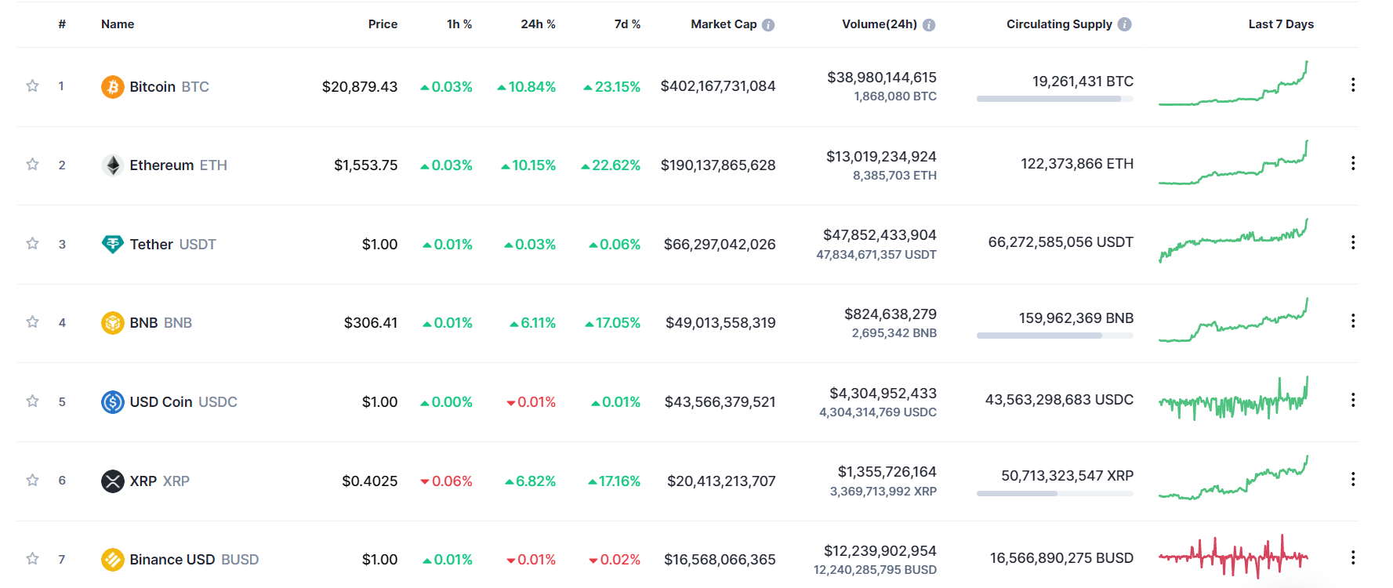
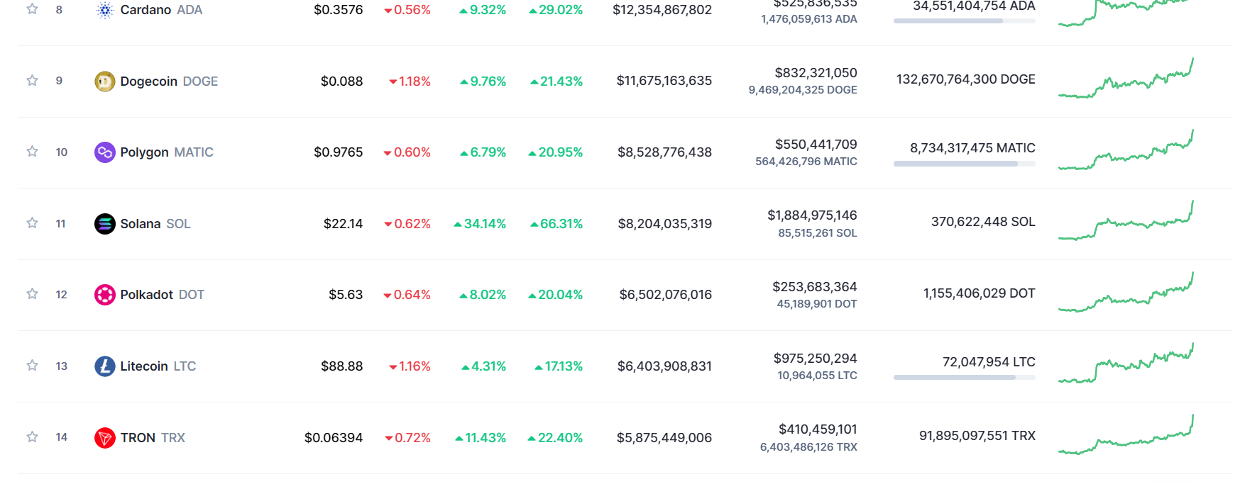
For more detail and real time data
https://coinmarketcap.com/

Slide 11
Bitcoin
Satoshi Nakamoto is a pseudonym for the person or people who helped develop the first bitcoin software and introduced the concept of cryptocurrency to the world in a 2008 paper. Nakamoto remained active in the creation of bitcoin and the blockchain until about 2010 but has not been heard from since.
Nakamoto was not the first to hit on the concept of cryptocurrency but was the one to solve a fundamental problem that prevented its adoption: Unlike paper currency, cryptocurrency could be duplicated. This was known as "double-spending," and Nakamoto solved it by creating the blockchain system of verification.

Slide 12
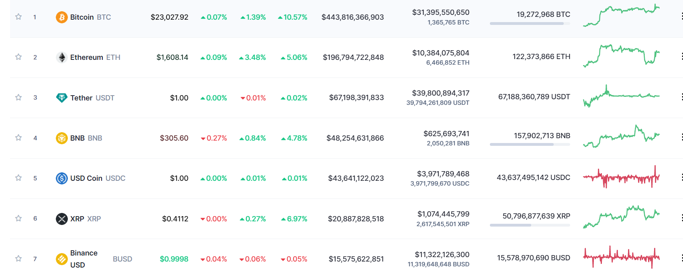
2023, Jan 22
2023, Jan 27

Slide 13
After analyzing the data of bitcoin for last 7 days we can see the difference
Market Capital
=$443,816,366,903-$402,167,731,084
=$41,648,635,819
Nepali market Value
= $41,648,635,819*129.60
=5,411,873,716,683.84 Nepalese Rupees
Price
=$23027.92-20879.43
=$2,148.49
Nepali Price Value
=$2148.49*129.60
=278444.304 Nepalese Rupees
As we know bitcoin is one of the most popular cryptocurrencies and here is its market valuation of it. From this, we can say that the demand for Cryptocurrency is at a rapid speed and you may be shocked if you got that this is the very low value of bitcoin in comparison to its value when it is at its peak.

Slide 14
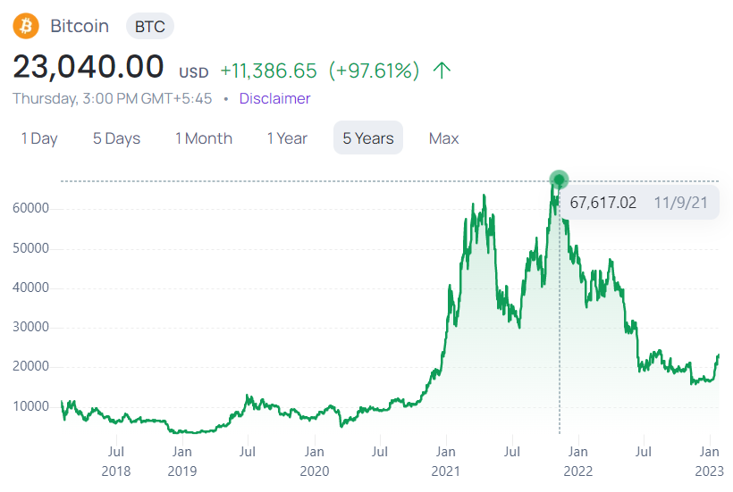
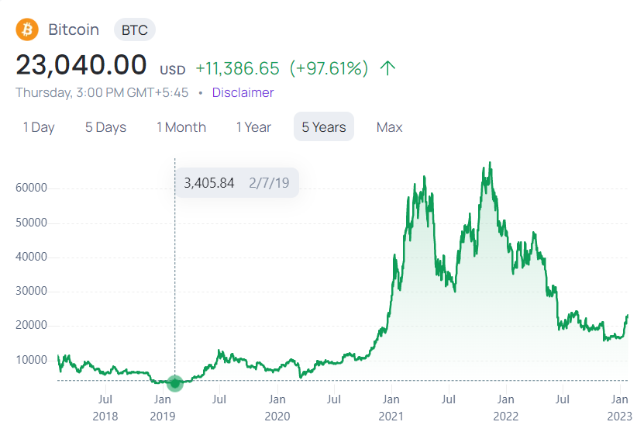
Prize Difference for bitcoin (Last 5 years data analysis)
Highest Price value of 1 bitcoin
Lowest Price value of 1 bitcoin

Slide 15
So after analyzing these data we can say that it is profitable along with loss
The price of bitcoin is not always the same. It is so fluctuating and cannot be predictable. If it is $35,000 today, it may be increased to $50,000 tomorrow or maybe decreased to $20,000.

Slide 16
So let’s take an example to understand it
For this analysis, we take the case of two people named Aryan and Lokesh.
Suppose both want to buy bitcoin, Aryan buy 10 bitcoins for $30,000 each on January 1, 2021, and sold them for $64,000 each on November 30, 2021. According to the stats, we know that in this interval the price of bitcoin is peak and Aryan sold it at peak price.
1 bitcoin = $30,000 (In Jan)
10 bitcoin = $30,000*10
=$300,000 (Total Investment)
1 bitcoin = $64,000 (In Nov)
10 bitcoins = $64,000*10
=$640,000 (Total Outcome)
Total Profit of Aryan = $640,000-$300,000 = $340,000
More than Investment
213.33% (Profit)

Slide 17
Now after that much profit he surely will get attention from the media or news reporters. His interview was out and another person name Lokesh saw that interview and got very excited to invest in bitcoin.
So he also bought 10 bitcoins for $65,000(each) in November, thinking of making a profit, but opposite his expectation, the price of bitcoin decreases instantly to $46,000 (each) in December. Then also he didn’t pull out his investment in hope of getting a profit but opposite his expectation, it goes in the decreasing line, then in fear of losing all money, he finally pulls out his investment at $32,000 for each bitcoin in June. Suddenly after his pull of money, the price of bitcoin goes up and reaches the highest of all time of $69,000 for each bitcoin
1 bitcoin = $65,000 (In Nov)
10 bitcoin = $65,000*10
=$650,000 (Total Investment)
1 bitcoin = $32,000 (In June)
10 bitcoins = $32,000*10
=$320,000 (Total Outcome)
Total loss of Lokesh = $640,000-$300,000 = $340,000
Less than Investment
49.23% (Loss)

Slide 18
In both of the cases of Aryan and Lokesh, we can see how much irregularity is in the case of the bitcoin price so many countries give banned the use of cryptocurrency.
Some of the countries where cryptocurrencies are banned:
Bangladesh
China
Nepal
Indonesia
Iran
North Korea
Ecuador
Russia
Vietnam
Egypt
Algeria
Pakistan
Saudi Arabia
UAE and many more… -[16]

Slide 19
HOW ARE TRANSACTIONS MADE IN CRYPTO?
It is obvious to get this type of question frequently nowadays as it’s a completely new trend of technology most probably following web 3.0.
Sending money from You to your friend
Sign into any Cryptocurrencies
Perform a transaction
Here,
When you click on send your crypto balance will be shifted from your account to the transaction pool (Transaction Pool is the place where all the transactions are messed up)
Then,
Miners play a vital role here, they do very hardcore complex calculations to find your unconfirmed transaction from the transaction pool and place it into Transaction Block (the same block forms a chain and becomes blockchain technology)
Now,
Your friend finally receives the currency you send. -[4]

Slide 20
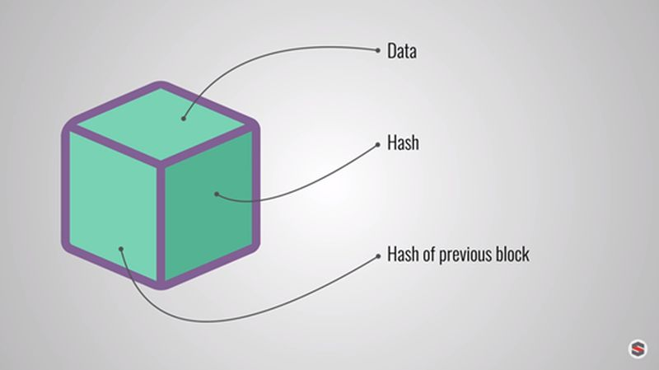
Process of Mining
Fig – Block
A block contains 5 different parts: -
• Block Number
• Data
• Nonce
• Previous Hash Value
• Hash Value
Note: - From these 5 different parts a miner can only change Nonce.

Slide 21
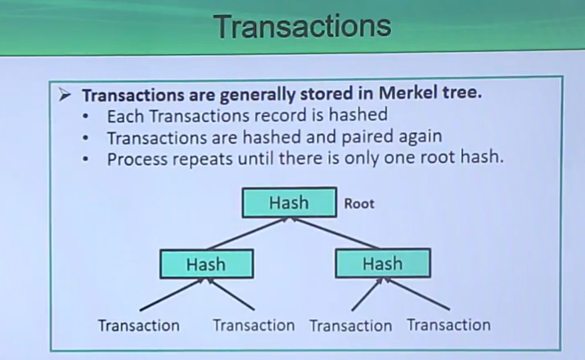
Let’s understand what function these five parts define,
Block Number- It is nothing but just counting the number of blocks in ascending order and is the default (The system generates this automatically).
Data- Data is nothing but just the information of the transaction may include the amount, name, and address.
Hash Value- Hash is system-generated unique Hexa-Decimal bits that can be of any Bit especially 4 8 16 32 64. It is used to write new transactions into the blockchain in the mining process.

Slide 22
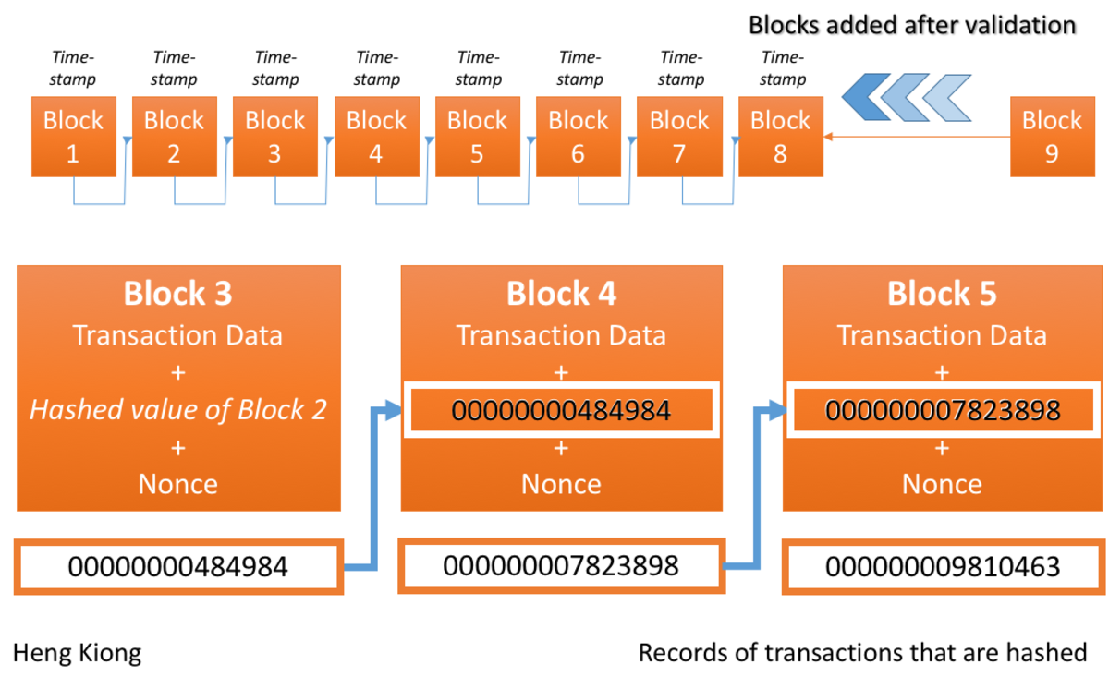
Previous Hash Value- Thousands of transactions occur in a minute so in every transaction we make there is going to be a PH value representing what hash was made before this transaction.
Nonce- The only thing that a miner guesses or perform a logical calculation are nonce it predicts the hash value specifying a target of hash.

Slide 23
References:
"Cryptocurrency" on Wikipedia, the free encyclopedia.
"What is Cryptocurrency?" by Investopedia.
"An Introduction to Cryptocurrency" by Forbes
"Blockchain" on Wikipedia, the free encyclopedia.
"How Does Cryptocurrency Work?" by Investopedia.
"An Introduction to Blockchain Technology" by Forbes.
"Bitcoin: A Peer-to-Peer Electronic Cash System" by Satoshi Nakamoto.
"Cryptography" on Wikipedia, the free encyclopedia.
"An Introduction to Cryptography" by Stanford University.
"Cryptography Basics" by Techopedia.
Handbook of Applied Cryptography by Alfred J. Menezes, Paul C. van Oorschot, and Scott A. Vanstone.
"Cryptography in Blockchain Technology" by Blockgeeks.
"Introduction to Modern Cryptography" by Jonathan Katz and Yehuda Lindell.
"The Basics of Bitcoins and Blockchains" by Antony Lewis.
"Blockchain Basics: A Non-Technical Introduction in 25 Steps" by Daniel Drescher.
"Bangladesh central bank bans use of cryptocurrencies" by BBC, a news website.
"Cryptocurrency regulation in China: a brief overview" by Oliver von Landsberg-Sadie.
"Cryptocurrency Ban in Nepal: What You Need to Know" by Crypto Head.
"Indonesia Tightens Regulation of Cryptocurrencies" by Nikkei Asia.
"Iran’s Ban on Crypto ‘Not Final’ and Regulations on the Way" by Cointelegraph.
"North Korea: Using Bitcoin To Evade Sanctions?" by Forbes.
"Ecuador’s Central Bank Shuts Down Cryptocurrency Exchanges" by Bitcoin Magazine.
"Russia may ban cryptocurrency exchanges" by The Moscow Times.
"Vietnam’s crypto crackdown: What you need to know" by Tech in Asia.
"Egypt’s Central Bank Joins Global Blockchain Alliance" by Cointelegraph.
"Algeria's central bank bans the use of cryptocurrencies" by Al Jazeera.
"Pakistan Central Bank Prohibits Crypto Trading" by Finance Magnates.
"Saudi Arabia Is Monitoring Cryptocurrency Transactions" by Finance Magnates.

